Slide 1
CIS 598 CheersPOS Store Data Transfer & Item Library
Victor Ramos

Slide 2
Background & Problem
Transferring store inventory data from one point of sale to another is currently done manually with Excel
Currently there is no easy way to iterate through a store's inventory data files
There is no item library to reference when transferring data

Slide 3
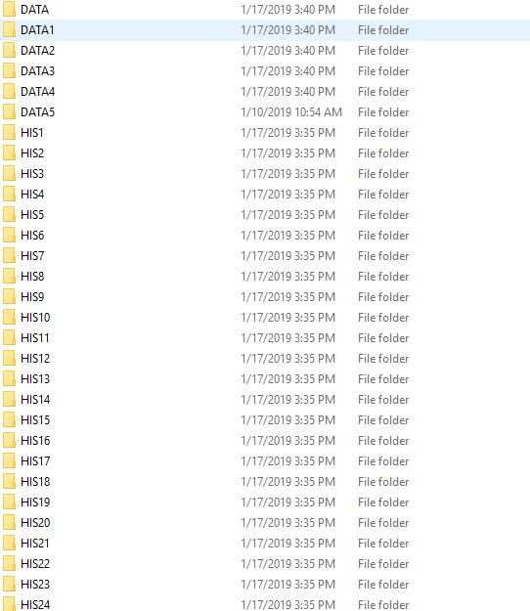

Slide 4
Goals
Provide an easy to use transfer tool that iterates through a store's inventory files and gets all the items data
Store and organize the store's inventory data in a database
Build tool as a web application to allow implementation into new point of sale
Allow database to grow with each new store transfer so that it can be used by new stores as an item library
Future, allow distributors to enter their inventory data
Future, allow for Pricebook integration

Slide 5
Features
Allow for different user types. I.E. Store owners, developers.
Transfer tool will be able to collect and clean inventory data from two different types of Points of Sale
Inventory Library will be editable to allow for any changes to data
Ability to browse Inventory Library by Distributor, Name, Category, SKU, UPC, or basic search
Ability to select certain inventory data and download it as a csv or pdf.
Allow database to be accessed by new Point of sale to allow for easy inventory transfer

Slide 6
Requirements
Application must be easy to use
Application must return clean inventory data. I.E. no repetitive items with the same SKU and Distributor
Application must be able to export data user selected
System must separate store owner view from developer view
A store's data must be separate from the Item Library. So the store owner cannot change the item library

Slide 7




Tools

Slide 8
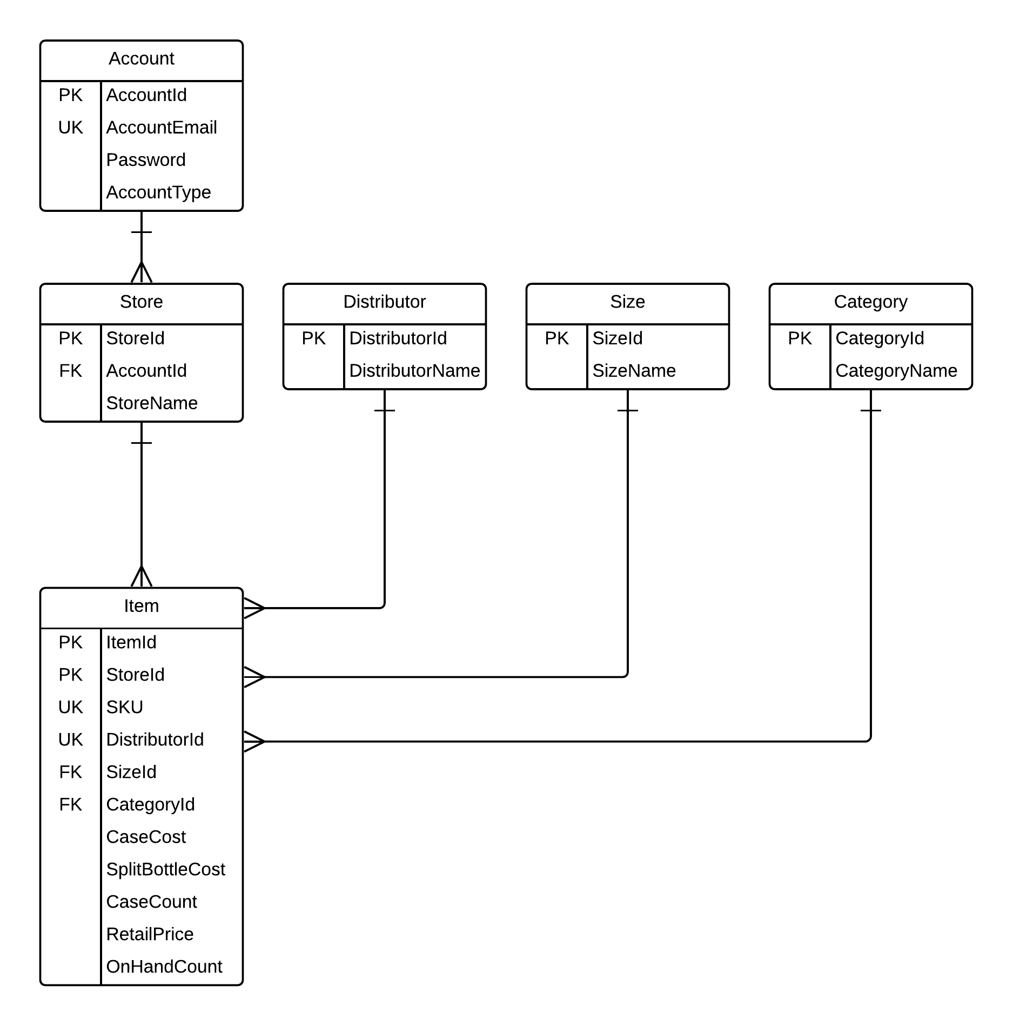
Database Design

Slide 9
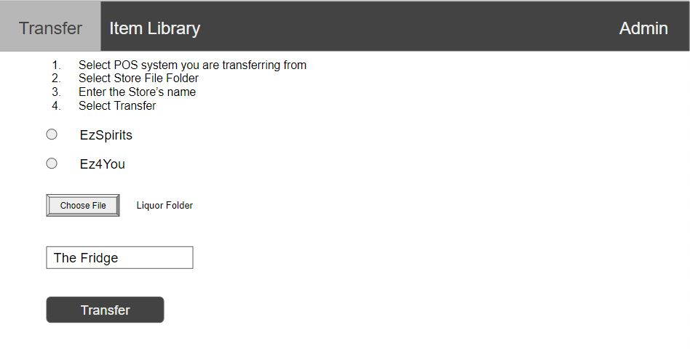

Slide 10
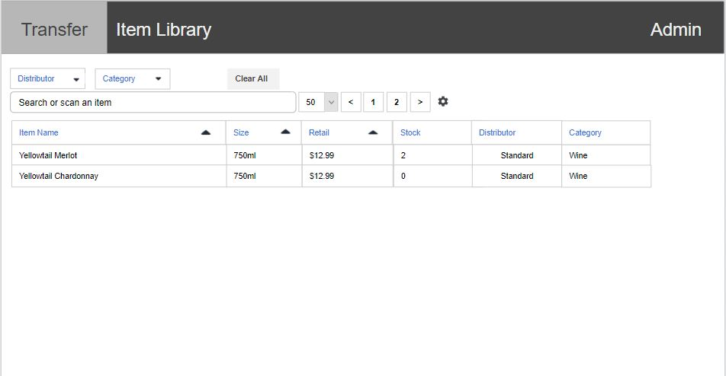

Slide 11
Development Schedule
End of September & Early October: Finalize database design and website design
Rest of October: Begin coding. Work on successful data transfer from other Points of Sale, account creation
November: Beautify website and finish website permission viewing
December: Finetune requirements and present work

Slide 12
Questions?

